Slide 1
Circadian Rhythms & Post-Traumatic Stress Disorder (PTSD)
Tyllis Xu

Slide 2
Post-Traumatic Stress Disorder
Duration > 1 month, after a traumatic event
Often associated with:
sleep fragmentation & nightmares
Slowed extinction of fear response
Affected stress response system

Slide 3
How PTSD relates to rhythms & sleep
PTSD associated with fragmented REM sleep, reduced sleep efficiency, disorganized sleep.
Disruptions to sleep-wake cycle linked to reduced fear response extinction & safety learning consolidation (in mice behavior models*)
An unbalanced stress-response system may provide feedback to the SCN and alter circadian rhythms
Theal 2019; Clark 2020; Agorastos 2020

Slide 4
PTSD Sleep Actigraph (Methods)
Selected 20 & 20 Vietnam War Veterans (VV) into PTSD-diagnosed group & trauma-exposed control group respectively
PTSD & trauma exposure screened by psych eval according to CAPS DSM-5, from VA volunteers
Tracking activity/sleep rhythms over 2 weeks
Theal 2019

Slide 5
PTSD Sleep Actigraph (Methods)
Polysomnography not used due to inconsistencies found prior studies w/ long durations
Used accelerometer & light sensor worn on non-dominant wrist combined with daily sleep diary
Did not measure sleep phase due to technique limitations
Theal 2019

Slide 6
PTSD Sleep Actigraph (Methods)
Accelerometer & light level measurements at 30 Hz
Daily paper sleep diary for:
sleep latency (SL), wake after sleep onset (WASO), total sleep time (TST), time in/out of bed
caffeine, alcohol, food, medication intake
napping frequency, duration, and timing
abnormal events
General sleep survey for: sleep patterns, nightmares, nighttime movements
“Scored by blinded sleep scientist, adjusted according to sleep diary”
Theal 2019

Slide 7
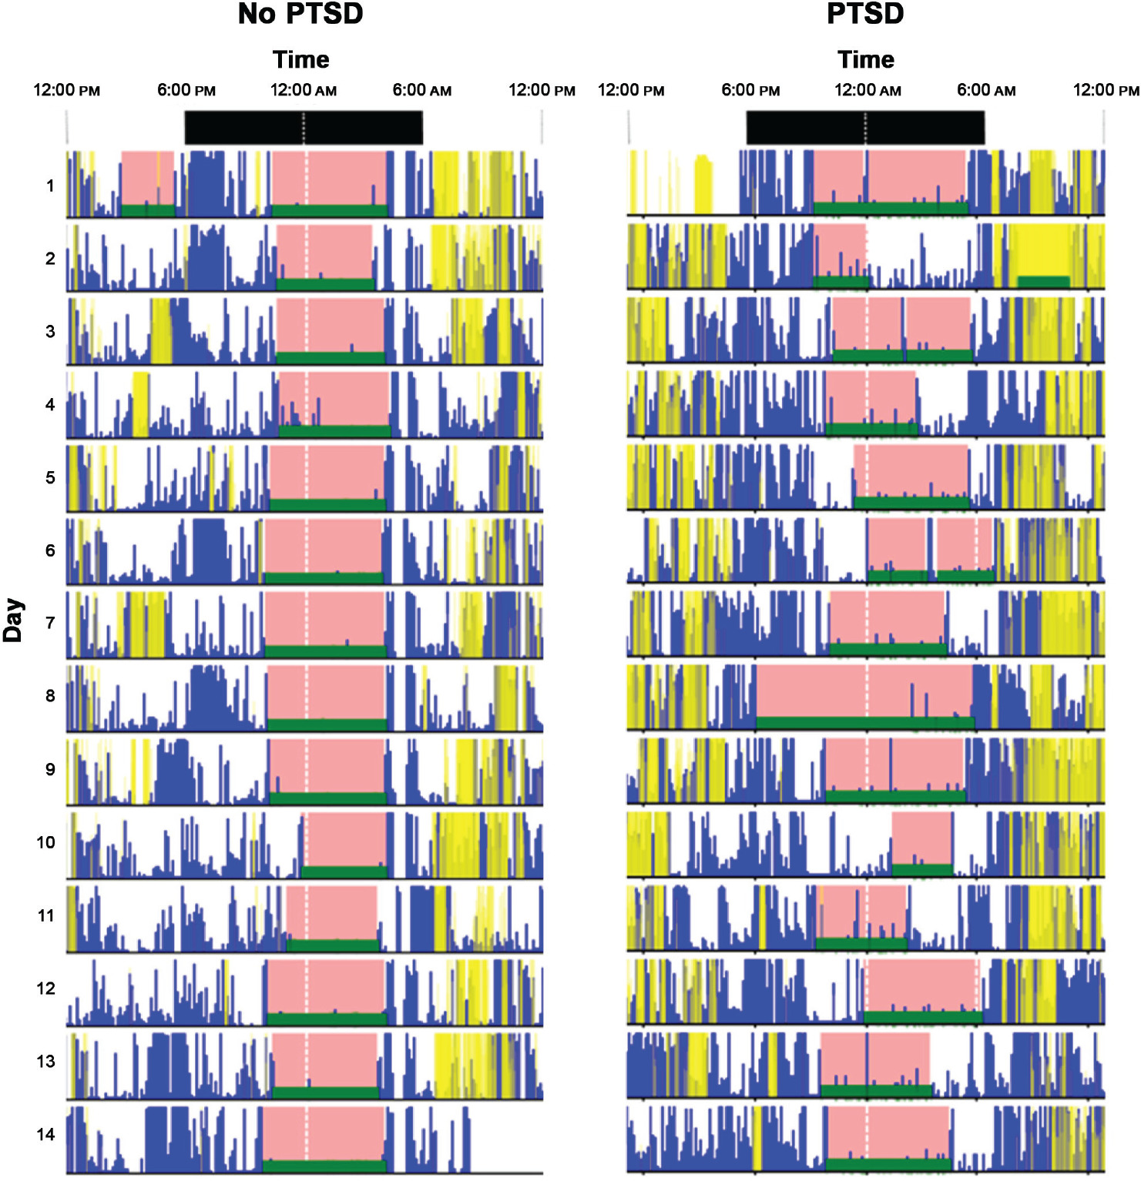
PTSD Sleep Actigraph (Results)
PTSD correlates with increased sleep latency
Strong correlation between objective and reported wake after sleep onset for control group but not for PTSD group
Theal 2019

Slide 8
Mice PTSD Behavior Model (Methods)
No known way of inducing PTSD in mice
Behavior model of fear extinction & safety learning using foot-shock associated with cue
Mice freeze in fear response. Used to measure fear entrainment, generalization, and extinction.
Clark 2020

Slide 9
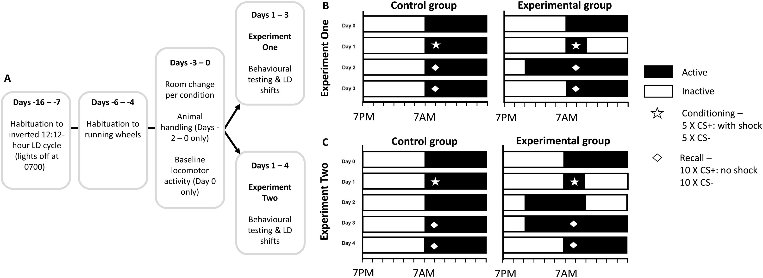
Mice PTSD Behavior Model (Schedule)
Clark 2020

Slide 10
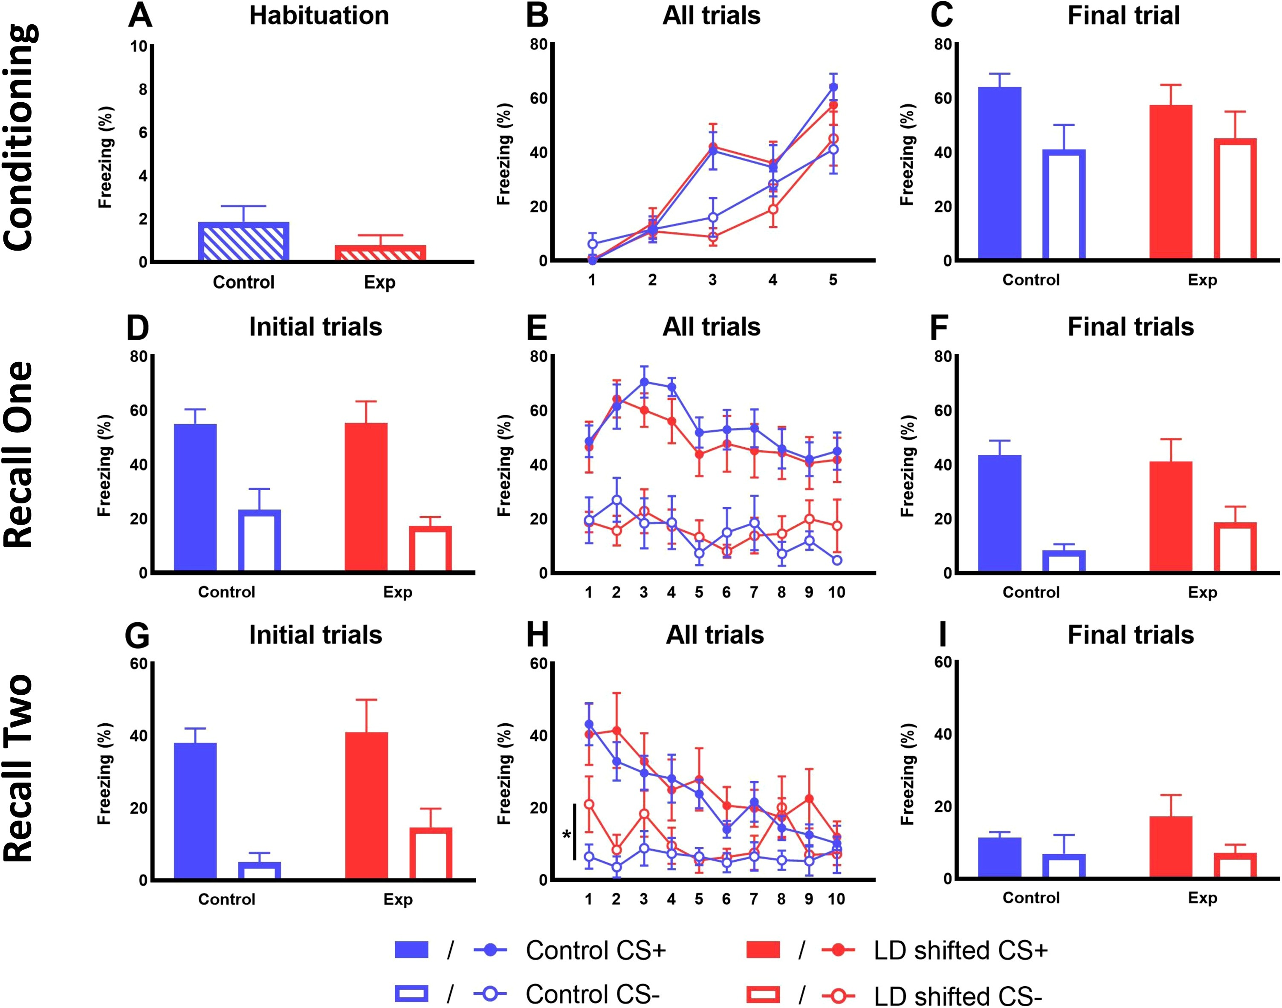
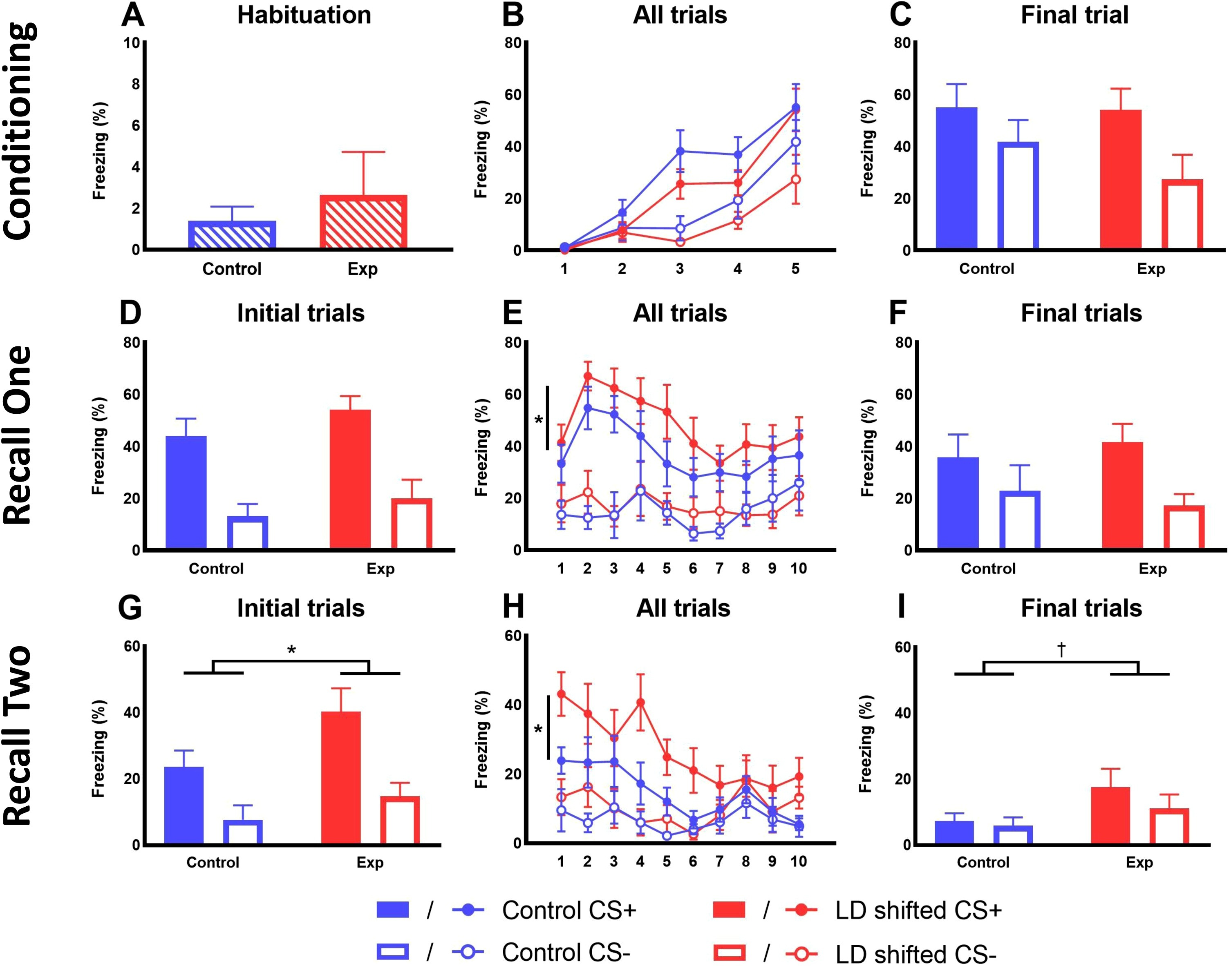
Mice PTSD Behavior Model (Results)
Experiment 1
Experiment 2
Clark 2020

Slide 11
Traumatic Stress & Circadian Clocks
The SCN provides rhythms to the human stress system
Upregulated human stress system can result in desynchronization of peripheral clocks from the SCN
Glucocortids from stress system may affect entrainment and phase of SCN
Agorastos 2020

Slide 12
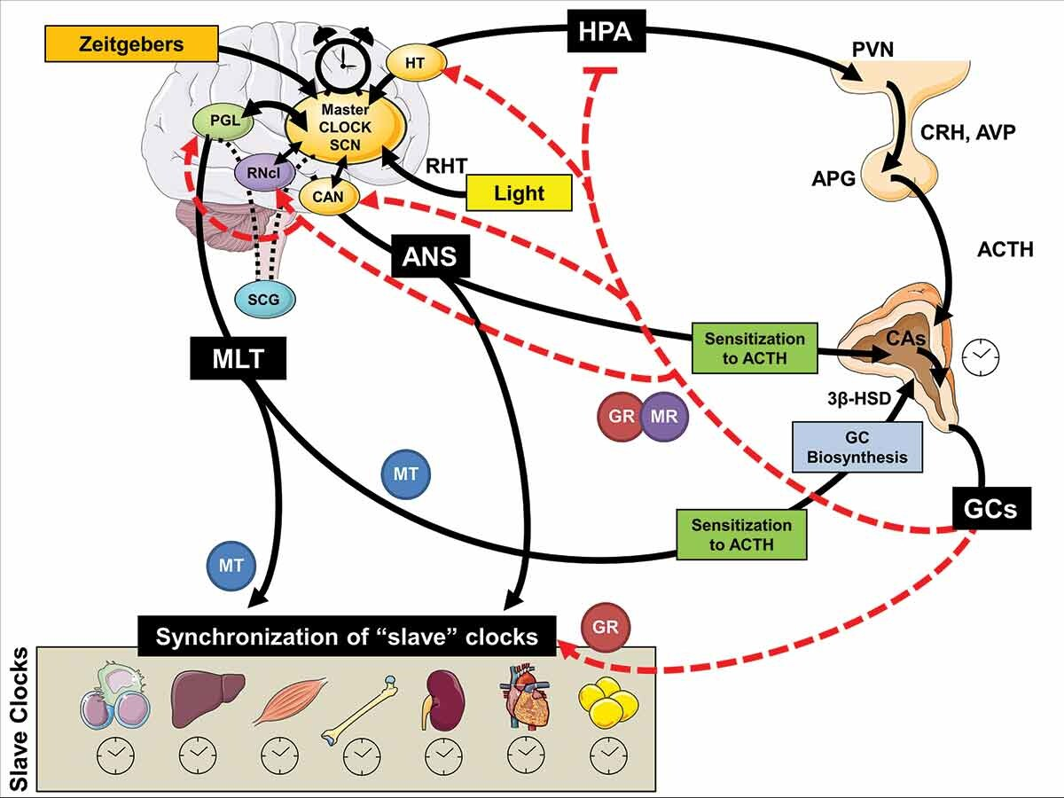
Traumatic Stress & Circadian Clocks

Slide 13
Speculated Treatment Directions
Reducing sleep disruptions/fragmentation using medication to adjust circadian rhythm as a supplementary measure to Cognitive Behavioral Therapy
Clark 2020

Slide 14
Sources
Agorastos, A., & Olff, M. (2020). Traumatic stress and the circadian system: neurobiology, timing and treatment of posttraumatic chronodisruption. European Journal of Psychotraumatology, 11(1). https://doi.org/10.1080/20008198.2020.1833644
Clark, J. W., Hoyer, D., Cain, S. W., Phillips, A., Drummond, S. P. A., & Jacobson, L. H. (2020). Circadian disruption impairs fear extinction and memory of conditioned safety in mice. Behavioural Brain Research, 393, 112788. https://doi.org/10.1016/j.bbr.2020.112788
Theal, R., McLeay, S., Gleeson, S., Lowrie, F., O’Sullivan, R., McLeay, S., Harvey, W., Romaniuk, M., Crawford, D., Colquhoun, D., McD Young, R., Dwyer, M., Gibson, J., O’Sullivan, R., Cooksley, G., Strakosch, C., Thomson, R., Voisey, J., & Lawford, B. (2019). Comparison of Sleep Patterns in Vietnam Veterans With and Without Posttraumatic Stress Disorder Using Wrist Actigraphy. Journal of Clinical Sleep Medicine, 15(5), 725–732. https://doi.org/10.5664/jcsm.7762

